Slide 1
CSE 161 – Design and Architecture of Computer Systems
Chapter 5 – Memory - Part 2

Slide 2
outline
main memory architectures
virtual memory
error correcting codes
memory hierarchy recap

Slide 3
Main Memory

Slide 4
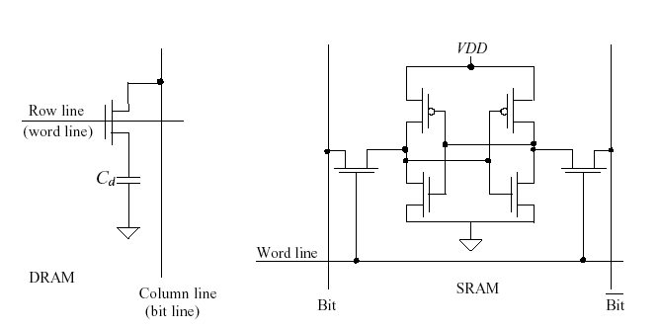
DRAM & SRAM
DRAM: 1 transistor/bit, requires refreshing of data, slow
SRAM: 4 to 6 transistors/bit, larger area, more power consumption, faster

Slide 5
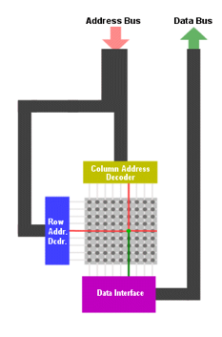
DRAM architecture
rectangular array or DRAM cells (bits)
split address bits between row and column accesses

Slide 6
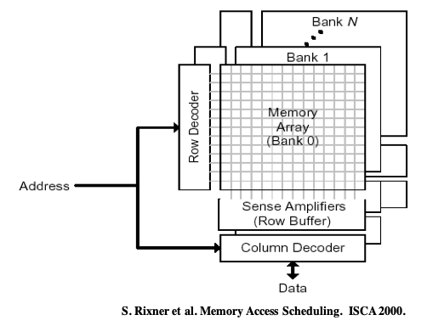
3D DRAM

Slide 7
advanced DRAM organization
Bits in a DRAM are organized as a rectangular array
DRAM accesses an entire row
Burst mode: supply successive words from a row with reduced latency
Double data rate (DDR) DRAM
Transfer on rising and falling clock edges
Quad data rate (QDR) DRAM
Separate DDR inputs and outputs

Slide 8
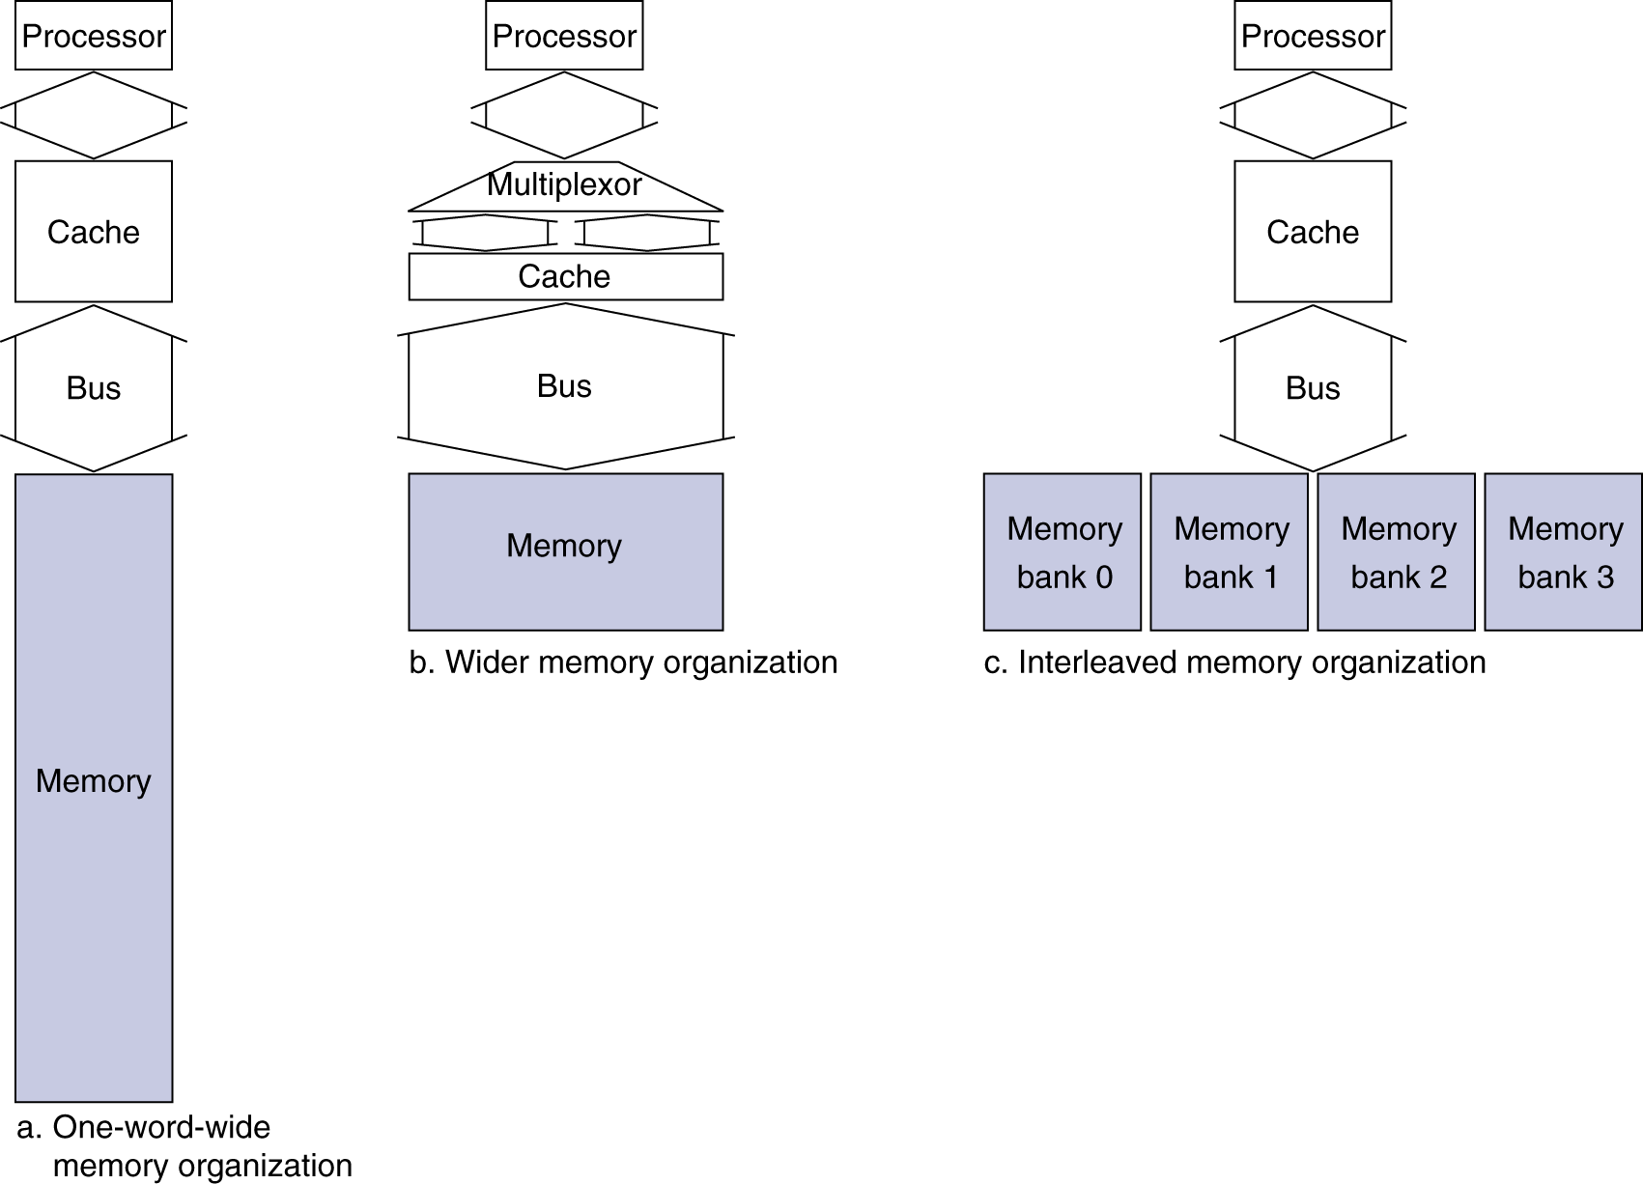
main memory architectures
Use DRAMs for main memory
Fixed width (e.g., 1 word)
Connected by fixed-width clocked bus
Bus clock is typically slower than CPU clock
Example cache block read
1 bus cycle for address transfer
15 bus cycles per DRAM access
1 bus cycle per data transfer
For 4-word block, 1-word-wide DRAM
Miss penalty = 1 + 4×15 + 4×1 = 65 bus cycles
Bandwidth = 16 bytes / 65 cycles = 0.25 B/cycle

Slide 9
wide memory
4-word wide memory
Miss penalty = 1 + 15 + 1 = 17 bus cycles
Bandwidth = 16 bytes / 17 cycles = 0.94 B/cycle

Slide 10
interleaved memory
4-bank interleaved memory
one word wide bank
banks accessed serially on the bus
Miss penalty = 1 + 15 + 4×1 = 20 bus cycles
Bandwidth = 16 bytes / 20 cycles = 0.8 B/cycle
address
address
address
address
0
1
2
3
4
5
6
7
8
9
10
11
12
13
14
15
Bank 0
Bank 1
Bank 2
Bank 3

Slide 11
DRAM generations
Year | Capacity | $/GB
1980 | 64Kbit | $1500000
1983 | 256Kbit | $500000
1985 | 1Mbit | $200000
1989 | 4Mbit | $50000
1992 | 16Mbit | $15000
1996 | 64Mbit | $10000
1998 | 128Mbit | $4000
2000 | 256Mbit | $1000
2004 | 512Mbit | $250
2007 | 1Gbit | $50

Slide 12
Virtual Memory

Slide 13
virtual memory
Use main memory as a “cache” for secondary (disk or SSD) storage
managed jointly by CPU hardware and the operating system (OS)
Programs share main memory
each process (executing program) gets its own private virtual address space
holding all its code and data
protected from other programs
CPU and OS translate virtual addresses to physical addresses
VM “block” is called a page
VM translation “miss” is called a page fault

Slide 14
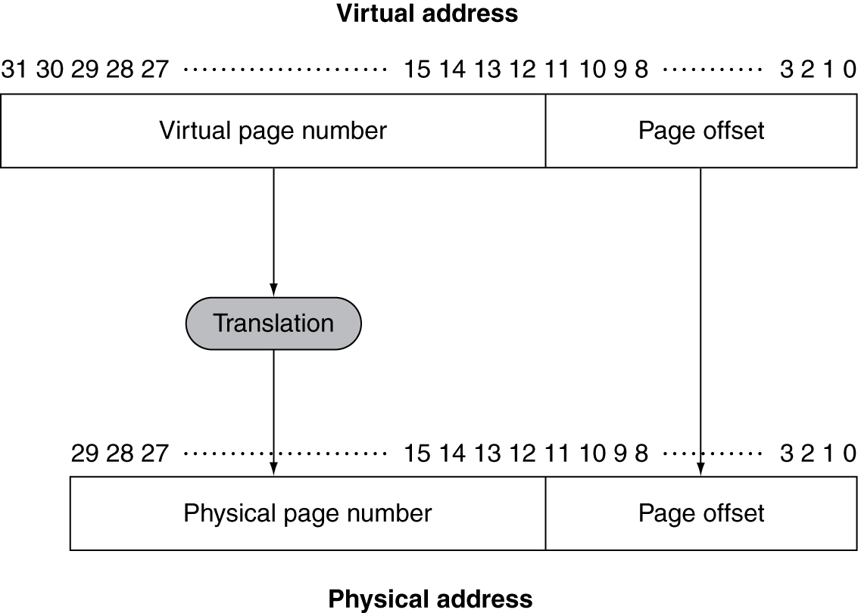
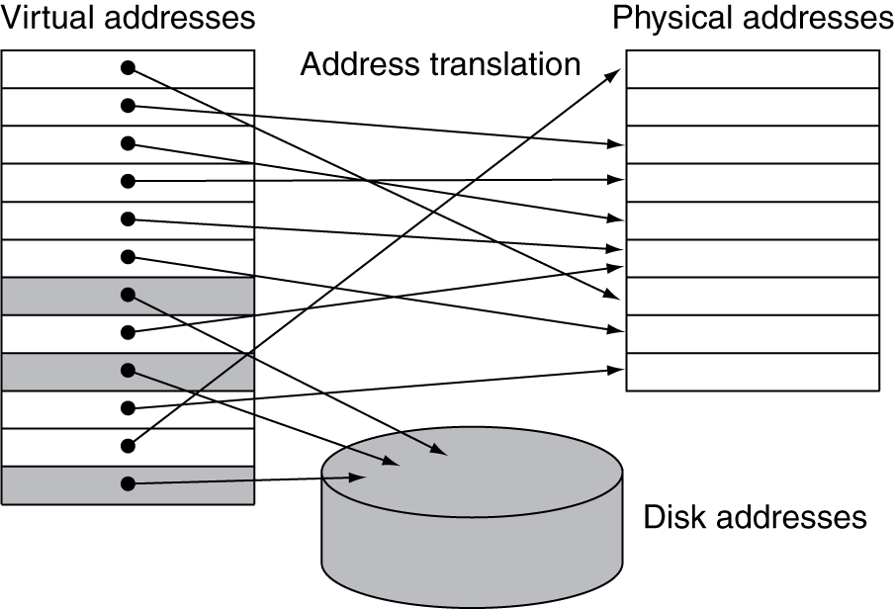
address translation
Fixed-size pages (e.g., 4K)

Slide 15
page fault penalty
On page fault, the page must be fetched from disk
Takes millions of clock cycles
Handled by OS code
Try to minimize page fault rate
Fully associative placement of pages in memory
Smart replacement algorithms, we have plenty of time

Slide 16
page tables
Stores placement information
Array of page table entries, indexed by virtual page number
Page table register in CPU points to page table in physical memory
If page is present in memory
PTE stores the physical page number
Plus other status bits (referenced, dirty, …)
If page is not present in memory
PTE can refer to location in swap space on disk

Slide 17
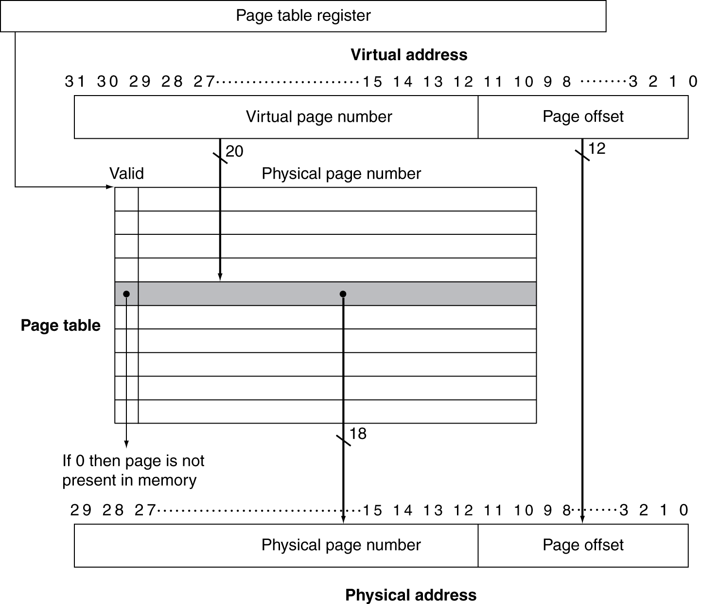
translation using a page table

Slide 18
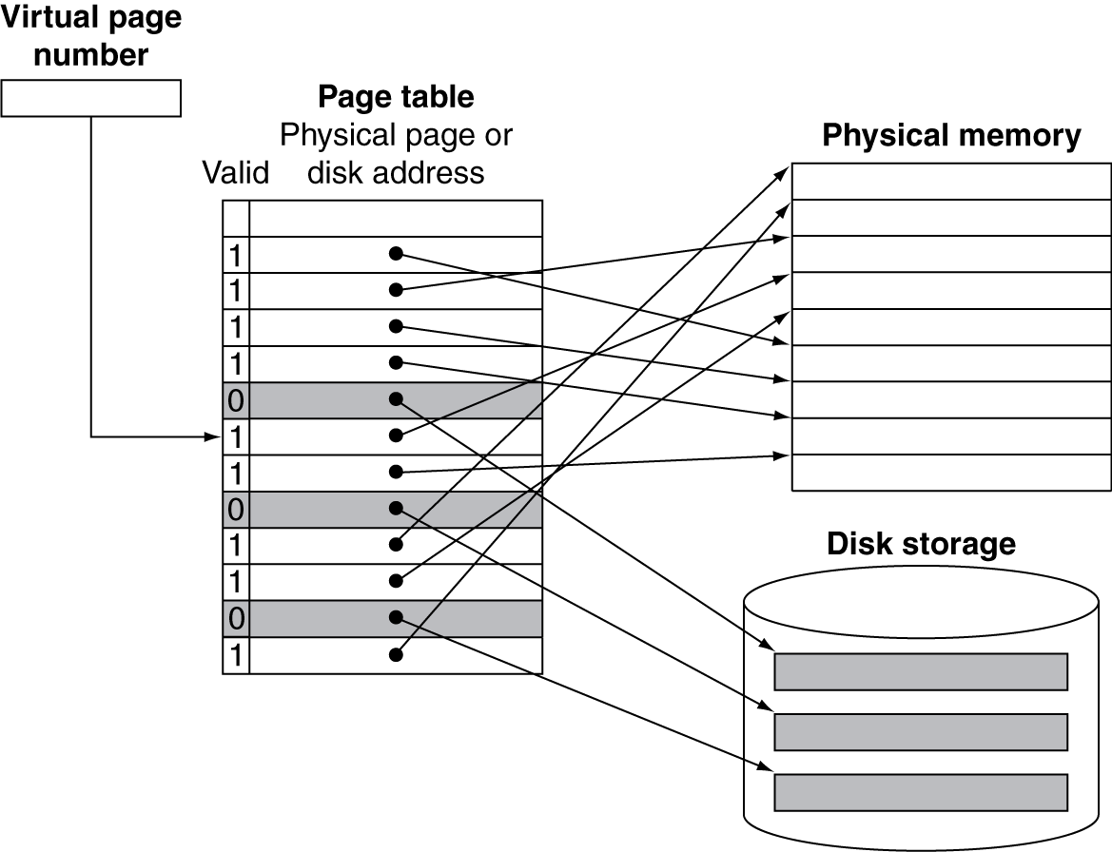
mapping pages to storage

Slide 19
replacement and writes
To reduce page fault rate, prefer least-recently used (LRU) replacement
Reference bit (aka use bit) in PTE set to 1 on access to page
Periodically cleared to 0 by OS
A page with reference bit = 0 has not been used recently
Disk writes take millions of cycles
Block at once, not individual locations
Write through is impractical
Use write-back
Dirty bit in PTE set when page is written

Slide 20
fast translation: TLB
Address translation would appear to require extra memory references
One to access the PTE
Then the actual memory access
But access to page tables has good locality
So use a fast cache of PTEs within the CPU
Called a Translation Look-aside Buffer (TLB)
Typical: 16–512 PTEs, 0.5–1 cycle for hit, 10–100 cycles for miss, 0.01%–1% miss rate
Misses could be handled by hardware or software

Slide 21
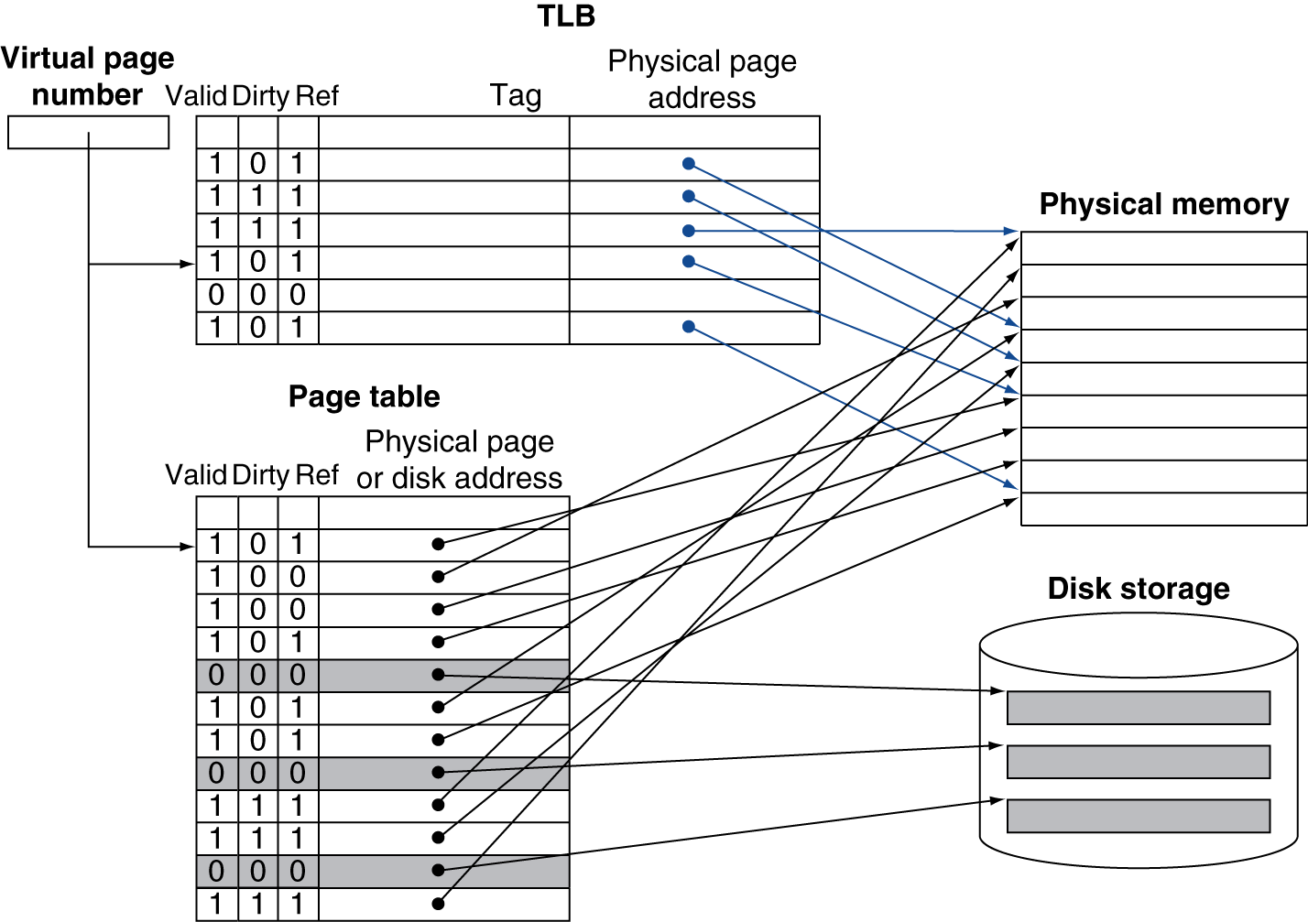
using a TLB

Slide 22
TLB misses
If page is in memory
Load the PTE from memory and retry
Could be handled in hardware
Can get complex for more complicated page table structures
Or in software
Raise a special exception, with optimized handler
If page is not in memory (page fault)
OS handles fetching the page and updating the page table
Then restart the faulting instruction

Slide 23
TLB miss handler
TLB miss indicates
Page present, but PTE not in TLB
Page not present
Must recognize TLB miss before destination register overwritten
Raise exception
Handler copies PTE from memory to TLB
Then restarts instruction
If page not present, page fault will occur

Slide 24
page fault handler
Use faulting virtual address to find PTE
Locate page on disk
Choose page to replace
If dirty, write to disk first
Read page into memory and update page table
Make process runnable again
Restart from faulting instruction

Slide 25
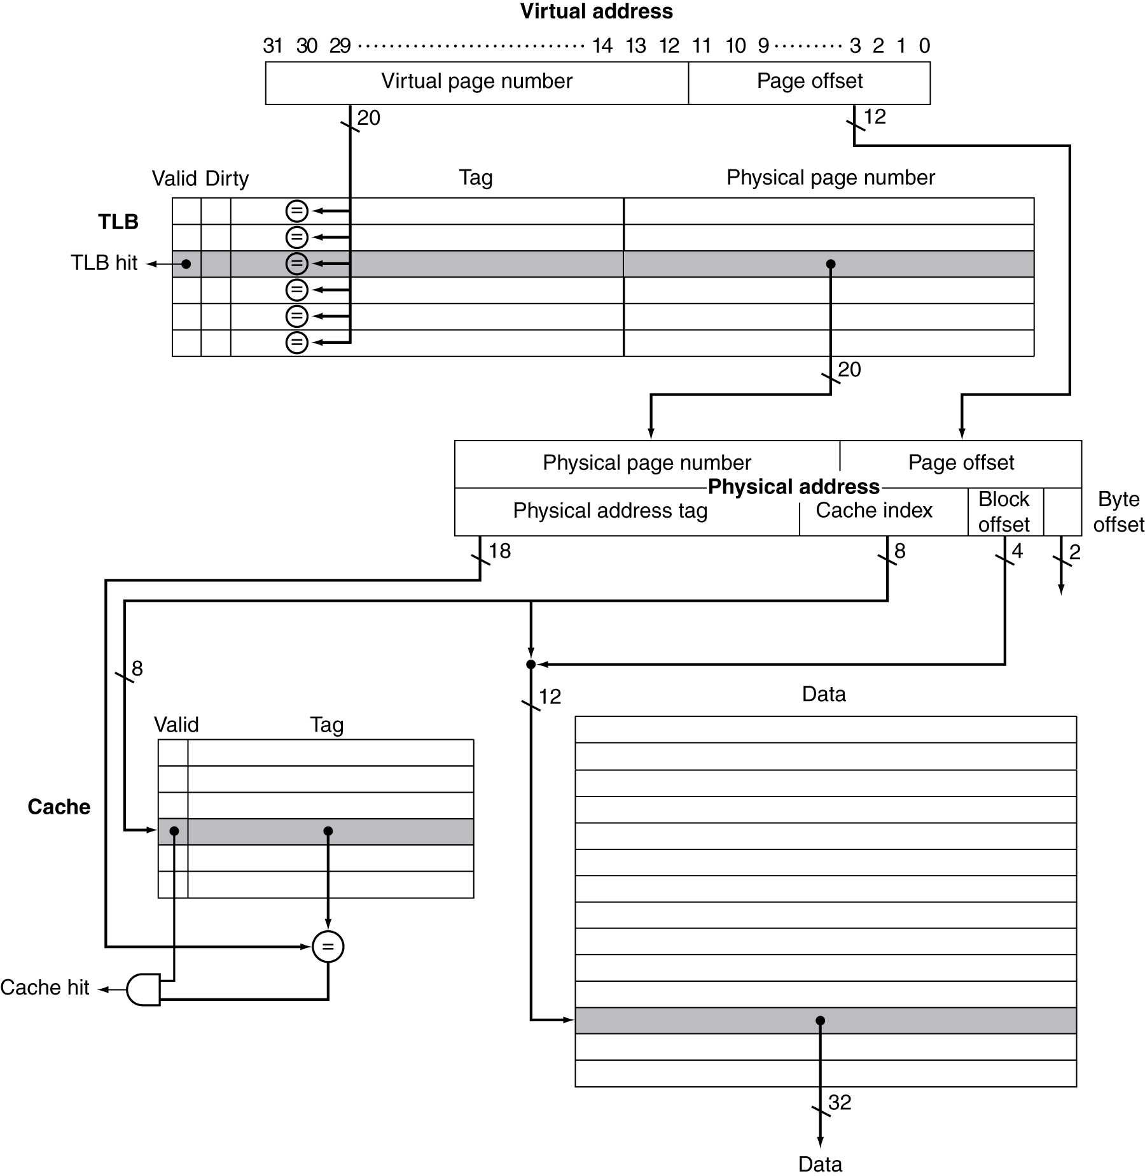
TLB and cache interaction
If cache tag uses physical address
Need to translate before cache lookup
Alternative: use virtual address tag
Complications due to aliasing
Different virtual addresses for shared physical address

Slide 26
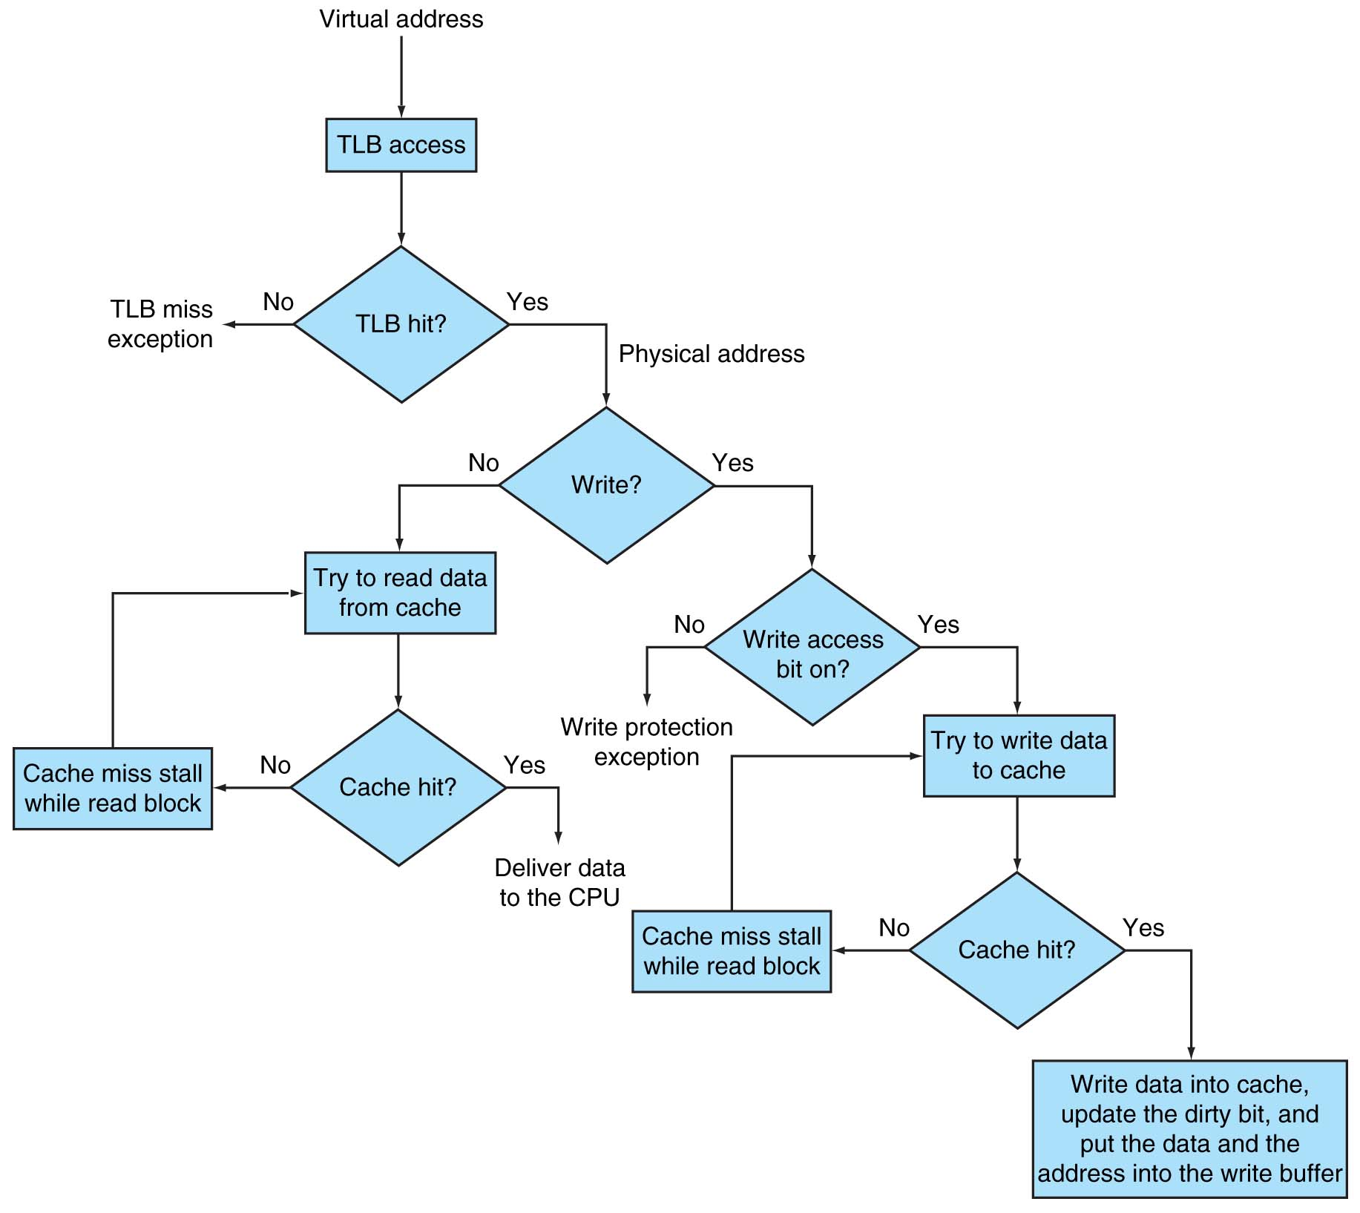
Intrinsity FastMATH TLB and cache

Slide 27
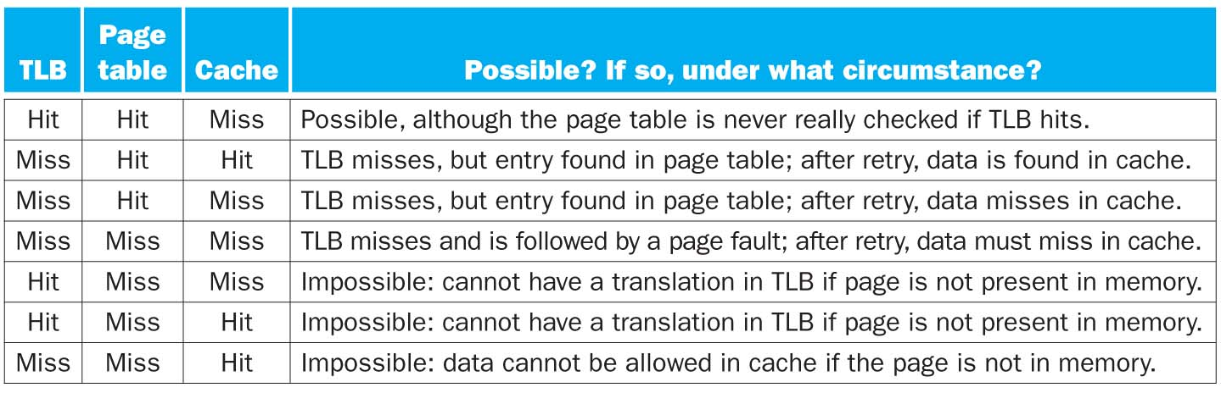
cache & virtual memory

Slide 28
memory protection - un-authorized access
Different tasks can share parts of their virtual address spaces
But need to protect against errant access
Requires OS assistance
Hardware support for OS protection
Privileged supervisor mode (aka kernel mode)
Privileged instructions
Page tables and other state information only accessible in supervisor mode
System call exception (e.g., syscall in MIPS)

Slide 29
memory protection – single event upset
SEU
= change of state of transistor caused by an ionizing particle
is not permanent.
unlike single event latchup (SEL), single event gate rupture (SEGR), or single event burnout (SEB).
caused by cosmic particles colliding with atoms in the atmosphere, creating showers of neutrons and protons
why does it matter?
shrinking size of transistors ➔ smaller charge ➔ less energy to change its state
it used to be that SEU were limited to outer space, upper atmosphere and close to nuclear radiations
not anymore

Slide 30
Error Correcting Codes
CS 161

Slide 31
why error correcting codes
noise in communication channels causes errors
e.g. WiFi, Bluetooth, etc.
sent: 0011 0010 1101
received: 0010 0110 1101
wires in circuits can act like antennas
electromagnetic radiation becomes digital data
single event upset (SEU)
cosmic particles collide with atoms in atmosphere, create showers of ionized particles (neutrons, protons), these can discharge transistors.
the smaller the transistor geometry, the lower the energy needed to keep its state

Slide 32
the Hamming SEC code
Hamming distance
Number of bits that are different between two binary strings
Hd (a, b) = population count (a XOR b)
General case (non binary): edit distance
Given two strings of equal length, it is the minimum number of substitutions required to change one strings into another:
sent OHLALA!
received OHLALU!
edit distance = 1

Slide 33
parity
to binary strings of size n (word),
add one extra bit (parity bit) such that the number of 1’s is always even (even parity)
⇒ the Hamming distance between any two correct words is 2
⇒ if a word has an odd number of 1s, one of its bits is in error
we cannot tell which one though
Minimum distance = 2
provides single bit error detection (parity code)
Minimum distance = 3
provides single error correction, 2 bit error detection

Slide 34
parity bit - SED
Parity bit
is an additional bit set to make the number of 1s even (or odd) in that word
it is a Single Error Detection (SED) mechanism.
in case of an error, the data is re-transmitted or re-fetched from memory.
7-bit data | #1s | 8-bits with parity
 |  | even | odd
0000000 | 0 | 00000000 | 00000001
0001111 | 4 | 00011110 | 00011111
0000111 | 3 | 00001111 | 00001110
1111111 | 7 | 11111111 | 11111110

Slide 35
parity checking
generating a parity bit
checking the parity
b₀
b₁
b₂
b₃
b₄
b₅
b₆
b₇
b₀
b₁
b₂
b₃
b₄
b₅
b₆
b₇
p
∑
p
∑
check bit
error if check bit != 0
two or an even number of errors are not detected

Slide 36
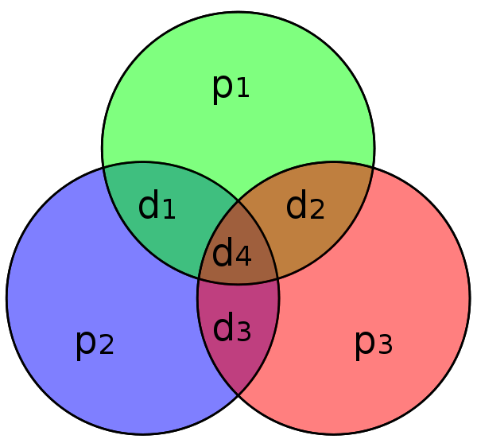
Hamming code [7,4]
Simplest Hamming code:
4 bits of data (d1:d4) and 3 parity bits (p1:p3)
[7,4] means total 7 bits, data is 4 bits
each parity bit covers 3 data bits
the Hamming distance of every encoded word is now 3
so it is possible to detect and correct a single error
but the decoder cannot distinguish between a single-bit error of a code word and the double-bit error of another code word

Slide 37
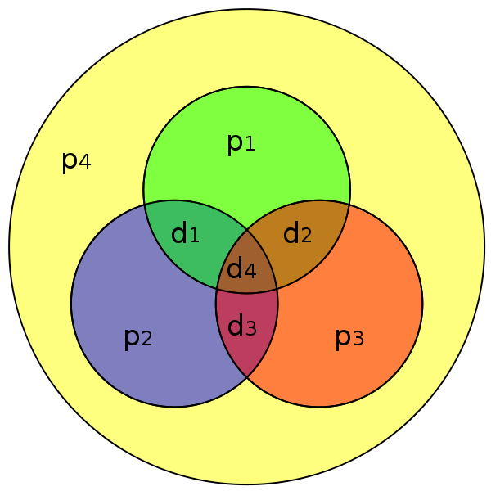
Hamming code [8,4]
Add a parity bit to the whole code word of the [7,4]
increases the Hamming distance to 4
allows SEC/DED
(i.e single error correction or double error detection)

Slide 38
encoding SECDED
Hamming code [12,8]
can achieve Single Error Correction (SEC) and Double Error Detection (DED)
To calculate Hamming code:
Number bits from 1 on the left
All bit positions that are a power 2 are parity bits
Each parity bit covers certain data bits:
Bit 1 (0001) for bits (1, 3, 5, 7, 9, 11, …): XXX1
Bit 2 (0010) for bits (2, 3, 6, 7, 10, 11, 14, 15, …): XX1X
Bit 4 (0100) for bits (4-7, 12-15, 20-23, …): X1XX
Bit 8 (1000) for bits (8-15, 24-31, 40-47, …): 1XXX
Note that each bit is covered by two or more parity bits.
Set parity bits to create even parity for each group.

Slide 39
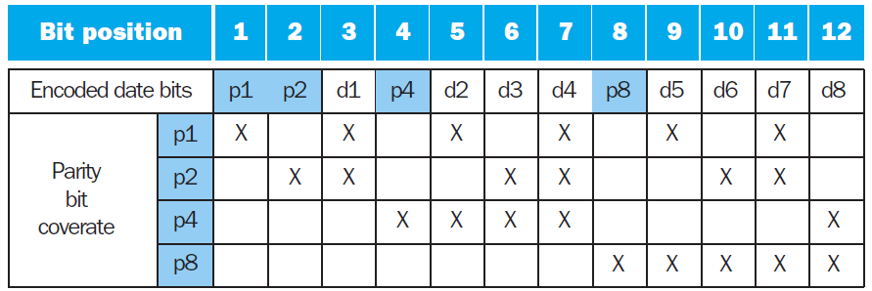
SECDED table [12,8]
 | 1 | 2 | 3 | 4 | 5 | 6 | 7 | 8 | 9 | 10 | 11 | 12
 | p1 | p2 | d1 | p4 | d2 | d3 | d4 | p8 | d5 | d6 | d7 | d8
data
p1
p2
p4
p8
encoded data

Slide 40
decoding SEC (12,8)
Value of parity bits indicates which bits are in error
Use numbering from encoding procedure
Textbook example: value = 10011010 (8 bits)
Encoded value = 011100101010 (12 bits: 8 data + 4 parity)
Parity bits = 0110 indicates no error
Assume bit 3 is flipped: 010100101010
Compute the new parity bits:
P1 - (bits 1,3,5,7,9,11: 0,0,0,1,1,1), Should be 1. ERROR
P2 - (bits 2,3,6,7,10,11: 1,0,0,1,0,1). Should be 0. ERROR
P4 - (bits 4-7, 12: 1,0,0,1,0). CORRECT
P8 - (bits 8-12: 0,1,0,1,0). CORRECT
Parity bits 1 and 2 are in error, 1+2 = 3 ← the bit in error

Slide 41
example
 | 1 | 2 | 3 | 4 | 5 | 6 | 7 | 8 | 9 | 10 | 11 | 12
 | p1 | p2 | d1 | p4 | d2 | d3 | d4 | p8 | d5 | d6 | d7 | d8
data |  |  | 1 |  | 0 | 0 | 1 |  | 1 | 0 | 1 | 0
p1 | 0 |  | 1 |  | 0 |  | 1 |  | 1 |  | 1
p2 |  | 1 | 1 |  |  | 0 | 1 |  |  | 0 | 1
p4 |  |  |  | 1 | 0 | 0 | 1 |  |  |  |  | 0
p8 |  |  |  |  |  |  |  | 0 | 1 | 0 | 1 | 0
encoded data | 0 | 1 | 1 | 1 | 0 | 0 | 1 | 0 | 1 | 0 | 1 | 0

Slide 42
example (2)
Assume bit 3 is flipped
bits 1 and 2 are incorrect
1+2 = 3, the bit position in error
 | 1 | 2 | 3 | 4 | 5 | 6 | 7 | 8 | 9 | 10 | 11 | 12
 | p1 | p2 | d1 | p4 | d2 | d3 | d4 | p8 | d5 | d6 | d7 | d8
encoded data | 0 | 1 | 0 | 1 | 0 | 0 | 1 | 0 | 1 | 0 | 1 | 0
p1 | 0 |  | 0 |  | 0 |  | 1 |  | 1 |  | 1
p2 |  | 1 | 0 |  |  | 0 | 1 |  |  | 0 | 1
p4 |  |  |  | 1 | 0 | 0 | 1 |  |  |  |  | 0
p8 |  |  |  |  |  |  |  | 0 | 1 | 0 | 1 | 0

Slide 43
SEC/DEC code
Add an additional parity bit for the whole word (p_{n})
Make Hamming distance = 4
Decoding:
Let H = SEC parity bits
H even, p_{n} even, no error
H odd, p_{n} odd, correctable single bit error
H even, p_{n} odd, error in p_{n} bit
H odd, p_{n} even, double error occurred
Note:
ECC DRAM uses SEC/DEC with 8 bits protecting each 64 bits, they are 72-bits wide

Slide 44
SEC generalization
Let p number of parity bits, d number of data bits
p parity bits can cover from 1 to (2^{p}– 1) total bits
there are (p+d) possible bit errors and 1 case of no error
so 2^{p} >= p+d+1
so p bits provide SEC for (p+d) bits, one more bit adds DED, so we get SEC/DED
p | d | total bits | name
2 | 1 | 3 | Hamming(3,1)
3 | 4 | 7 | Hamming(7,4)
4 | 11 | 15 | Hamming(15,11)
5 | 26 | 31 | Hamming(31,26)
p | 2^{p} - p - 1 | 2^{p} - 1
d = | 8 | 16 | 32 | 64
p = | 4 | 5 | 6 | 7

Slide 45
example
Min number of parity bits to protect a 128-bit word using the SEC/DED?
9 bits. How?

Slide 46
More on Memory

Slide 47
The Memory Hierarchy
The BIG Picture
Common principles apply at all levels of the memory hierarchy
Based on notions of caching
At each level in the hierarchy
Block placement
Finding a block
Replacement on a miss
Write policy

Slide 48
finding a block
Associativity | Location method | Tag comparisons
Direct mapped | Index | 1
n-way set associative | Set index, then search entries within the set | n
Fully associative | Search all entries | #entries
 | Full lookup table | 0
Hardware caches
Reduce comparisons to reduce cost
Virtual memory
Full table lookup makes full associativity feasible
Benefit in reduced miss rate

Slide 49
replacement
Choice of entry to replace on a miss
Least recently used (LRU)
Complex and costly hardware for high associativity
Random
Close to LRU, easier to implement
Virtual memory
LRU approximation with hardware support

Slide 50
write policy
Write-through
Update both upper and lower levels
Simplifies replacement, but may require write buffer
Write-back
Update upper level only
Update lower level when block is replaced
Need to keep more state
Virtual memory
Only write-back is feasible, given disk write latency

Slide 51
sources of misses
Compulsory misses (aka cold start misses)
First access to a block
Capacity misses
Due to finite cache size
A replaced block is later accessed again
Conflict misses (aka collision misses)
In a non-fully associative cache
Due to competition for entries in a set
Would not occur in a fully associative cache of the same total size

Slide 52
ISA support
User and System modes
Privileged instructions only available in system mode
Trap to system if executed in user mode
All physical resources only accessible using privileged instructions
Including page tables, interrupt controls, I/O registers
Renaissance of virtualization support
Current ISAs (e.g., x86) adapting

Slide 53
cache control
Example cache characteristics
Direct-mapped, write-back, write allocate
Block size: 4 words (16 bytes)
Cache size: 16 KB (1024 blocks)
32-bit byte addresses
Valid bit and dirty bit per block
Blocking cache
CPU waits until access is complete
31
10
9
4
3
0
Tag
Index
Offset
18 bits
10 bits
4 bits

Slide 54
interface signals
Read/Write
Read/Write
Valid
Valid
Address
32
Address
32
CPU
Write Data
32
Cache
Write Data
128
Memory
Read Data
32
Read Data
128
Ready
Ready
Multiple cycles per access

Slide 55
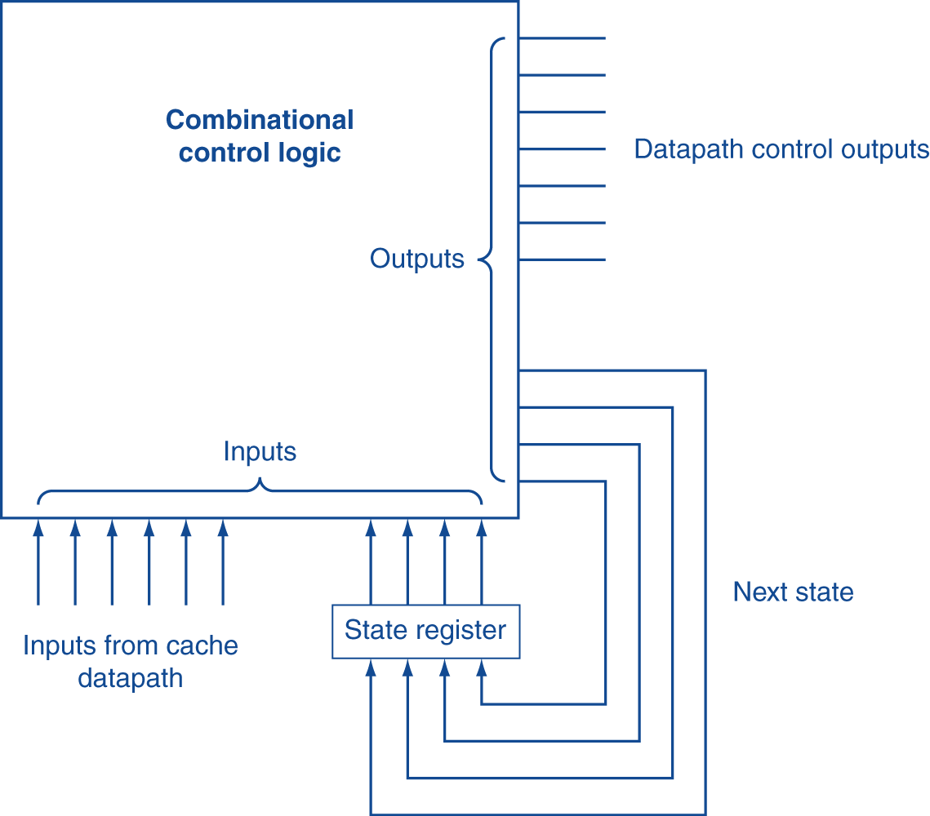
finite state machines
Use an FSM to sequence control steps
Set of states, transition on each clock edge
State values are binary encoded
Current state stored in a register
Next state = f_{n} (current state, current inputs)
Control output signals = f_{o} (current state)

Slide 56
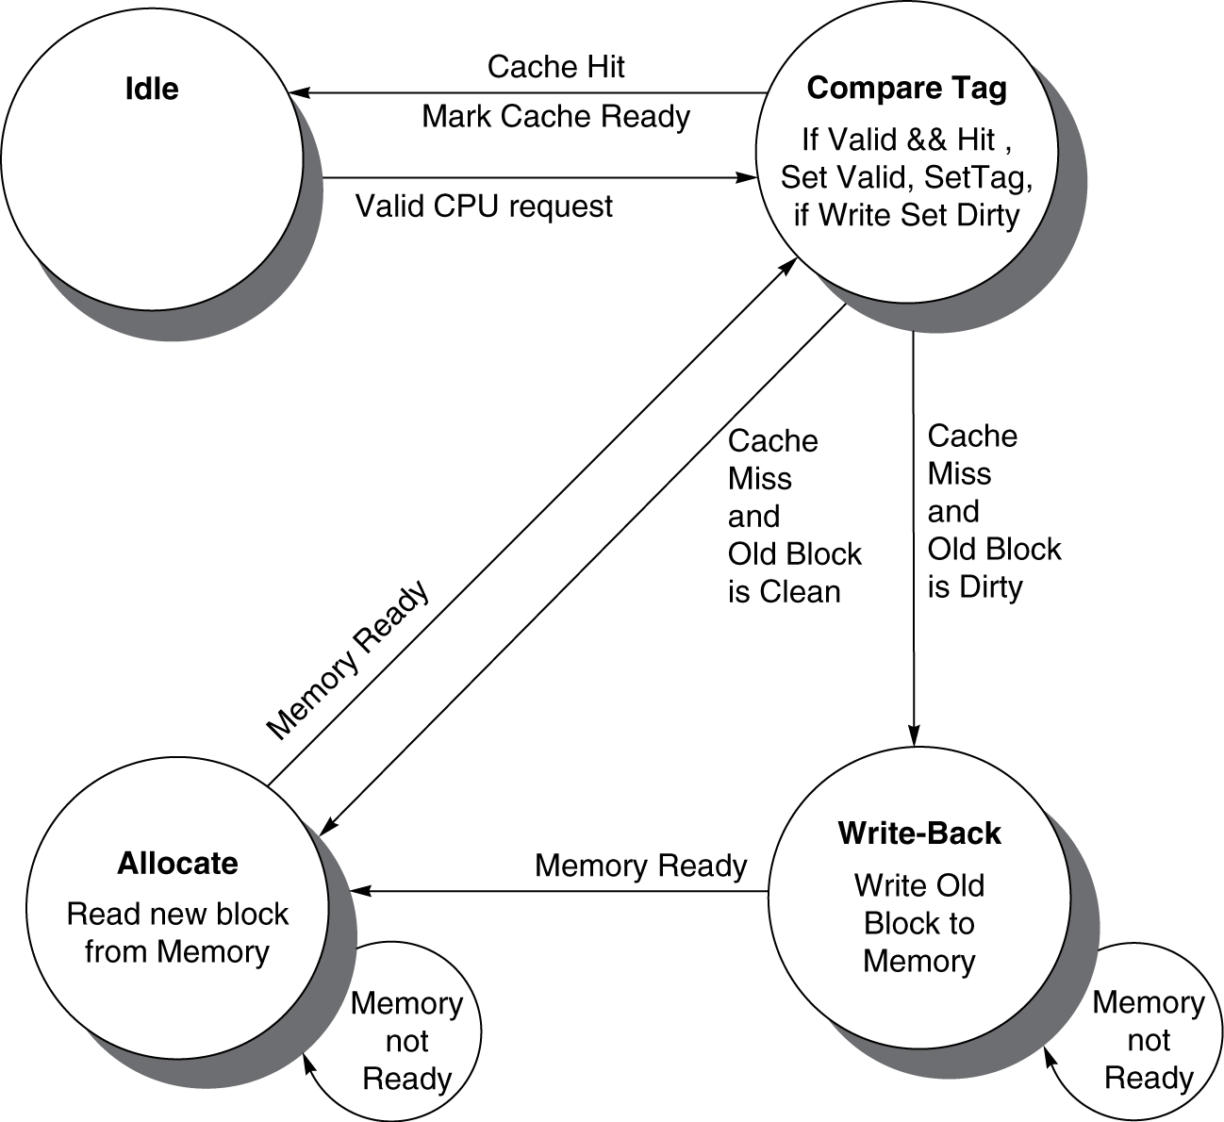
cache controller FSM
Could partition into separate states to reduce clock cycle time

Slide 57
cache coherence problem
Suppose two CPU cores share a physical address space
Write-through caches
Time step | Event | CPU A’s cache | CPU B’s cache | Memory
0 |  |  |  | 0
1 | CPU A reads X | 0 |  | 0
2 | CPU B reads X | 0 | 0 | 0
3 | CPU A writes 1 to X | 1 | 0 | 1

Slide 58
coherence defined
Informally:
Reads return most recently written value
Formally:
P writes X; P reads X (no intervening writes) read returns written value
P₁ writes X; P₂ reads X (sufficiently later) read returns written value
c.f. CPU B reading X after step 3 in example
P₁ writes X, P₂ writes X all processors see writes in the same order
End up with the same final value for X

Slide 59
cache coherence protocols
Operations performed by caches in multiprocessors to ensure coherence
Migration of data to local caches
Reduces bandwidth for shared memory
Replication of read-shared data
Reduces contention for access
Snooping protocols
Each cache monitors bus reads/writes
Directory-based protocols
Caches and memory record sharing status of blocks in a directory

Slide 60
snooping protocols
Cache gets exclusive access to a block when it is to be written
Broadcasts an invalidate message on the bus
Subsequent read in another cache misses
Owning cache supplies updated value
CPU activity | Bus activity | CPU A’s cache | CPU B’s cache | Memory
 |  |  |  | 0
CPU A reads X | Cache miss for X | 0 |  | 0
CPU B reads X | Cache miss for X | 0 | 0 | 0
CPU A writes 1 to X | Invalidate for X | 1 |  | 1
CPU B read X | Cache miss for X | 1 | 1 | 1

Slide 61
memory consistency
When are writes seen by other processors
“Seen” means a read returns the written value
Can’t be instantaneously
Assumptions
A write completes only when all processors have seen it
A processor does not reorder writes with other accesses
Consequence
P writes X then writes Y => all processors that see new X and then see new Y
Processors can reorder reads, but not writes

Slide 62
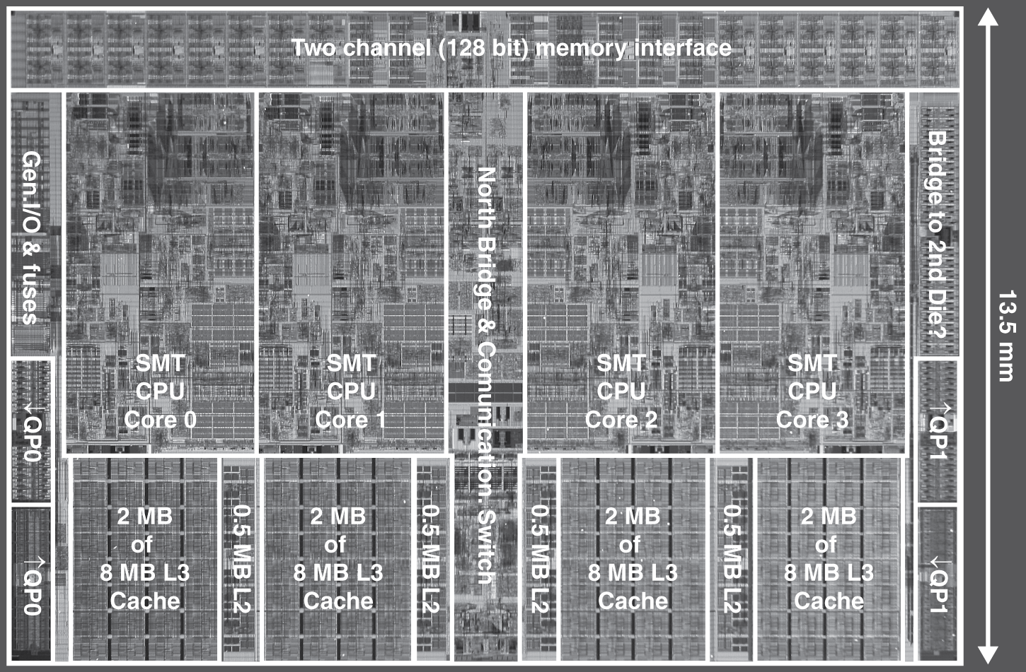
multilevel on-chip caches
Intel Nehalem 4-core processor
Per core: 32KB L1 I-cache, 32KB L1 D-cache, 512KB L2 cache

Slide 63
2-level TLB organization
 | Intel Nehalem | AMD Opteron X4
Virtual addr | 48 bits | 48 bits
Physical addr | 44 bits | 48 bits
Page size | 4KB, 2/4MB | 4KB, 2/4MB
L1 TLB (per core) | L1 I-TLB: 128 entries for small pages, 7 per thread (2×) for large pages L1 D-TLB: 64 entries for small pages, 32 for large pages Both 4-way, LRU replacement | L1 I-TLB: 48 entries L1 D-TLB: 48 entries Both fully associative, LRU replacement
L2 TLB (per core) | Single L2 TLB: 512 entries 4-way, LRU replacement | L2 I-TLB: 512 entries L2 D-TLB: 512 entries Both 4-way, round-robin LRU
TLB misses | Handled in hardware | Handled in hardware

Slide 64
3-level cache organization
 | Intel Nehalem | AMD Opteron X4
L1 caches (per core) | L1 I-cache: 32KB, 64-byte blocks, 4-way, approx LRU replacement, hit time n/a L1 D-cache: 32KB, 64-byte blocks, 8-way, approx LRU replacement, write-back/allocate, hit time n/a | L1 I-cache: 32KB, 64-byte blocks, 2-way, LRU replacement, hit time 3 cycles L1 D-cache: 32KB, 64-byte blocks, 2-way, LRU replacement, write-back/allocate, hit time 9 cycles
L2 unified cache (per core) | 256KB, 64-byte blocks, 8-way, approx LRU replacement, write-back/allocate, hit time n/a | 512KB, 64-byte blocks, 16-way, approx LRU replacement, write-back/allocate, hit time n/a
L3 unified cache (shared) | 8MB, 64-byte blocks, 16-way, replacement n/a, write-back/allocate, hit time n/a | 2MB, 64-byte blocks, 32-way, replace block shared by fewest cores, write-back/allocate, hit time 32 cycles
n/a: data not available

Slide 65
miss penalty reduction
Return requested word first
Then back-fill rest of block
Non-blocking miss processing
Hit under miss: allow hits to proceed
Miss under miss: allow multiple outstanding misses
Hardware prefetch: instructions and data
Opteron X4: bank interleaved L1 D-cache
Two concurrent accesses per cycle

Slide 66
pitfalls
Byte vs. word addressing
Example: 32-byte direct-mapped cache, 4-byte blocks
Byte 36 maps to block 1
Word 36 maps to block 4
Ignoring memory system effects when writing or generating code
Example: iterating over rows vs. columns of arrays
Large strides result in poor locality

Slide 67
pitfalls
In multiprocessor with shared L2 or L3 cache
Less associativity than cores results in conflict misses
More cores, need to increase associativity
Using AMAT to evaluate performance of out-of-order processors
Ignores effect of non-blocked accesses
Instead, evaluate performance by simulation

Slide 68
pitfalls
Extending address range using segments
E.g., Intel 80286
But a segment is not always big enough
Makes address arithmetic complicated

Slide 69
concluding remarks
Fast memories are small, large memories are slow
We really want fast, large memories ☹
Caching gives this illusion ☺
Principle of locality
Programs use a small part of their memory space frequently
Memory hierarchy
L1 cache, L2 cache, DRAM memory, disk
Memory system design is critical for multiprocessors

